Slide 1
DATA-DRIVEN AIRCRAFT ACCIDENT ANALYSIS
ANALYST: CHARLES OWITI

Slide 2
OVERVIEW
The company is expanding into the aviation industry but lacks insights into the risks associated with different aircraft.
To ensure a safe and profitable entry into this industry, we need to identify the lowest-risk aircraft models for commercial and private operations.
This analysis examines historical accident data, focusing on aircraft make and model, engine type, and flight purpose to identify trends in safety and risk.
The findings will provide data-driven recommendations to guide in decisions making and minimize operational risks.

Slide 3
Business Understanding
The company is expanding into the aviation industry and wants to acquire aircrafts.
The focus of the analysis is to determine which aircraft models are safest for commercial and private use.
Decision-makers require clear, and data-backed insights to minimize risk and optimize investment.
Key Business Objectives
Determine which aircraft models have the lowest accident rates.
Identify key risk factors such weather, flight phase, aircraft manufacturer.
Provide three concrete business recommendations to guide aircraft purchase decisions.

Slide 4
Data Understanding
A deeper dive into understanding the data

Slide 5
Data Understanding
Dataset Insight
The dataset consists of 88,889 rows and 31 columns.
Data was cleaned to ensure that all missing values are dealt with.
Key Variables Analyzed:
Aircraft Make & Model - safety
Engine Type – Reliability
Number of Engines – Reliability
Purpose of Flight - risk levels
Data Source: Aviation Accident Database & Synopses up to 2023

Slide 6
Data Analysis
Deeper understanding of the data

Slide 7
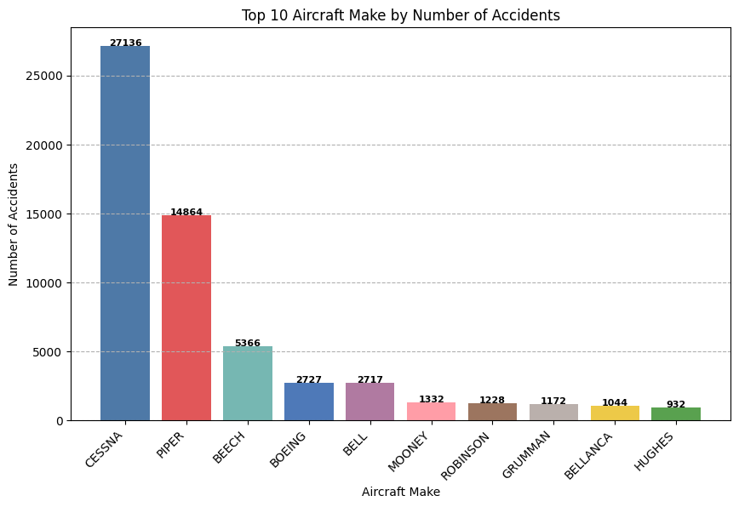
Make Analysis by Number of Accidents
Make such as CESSNA and PIPER have high number of accidents reported.

Slide 8
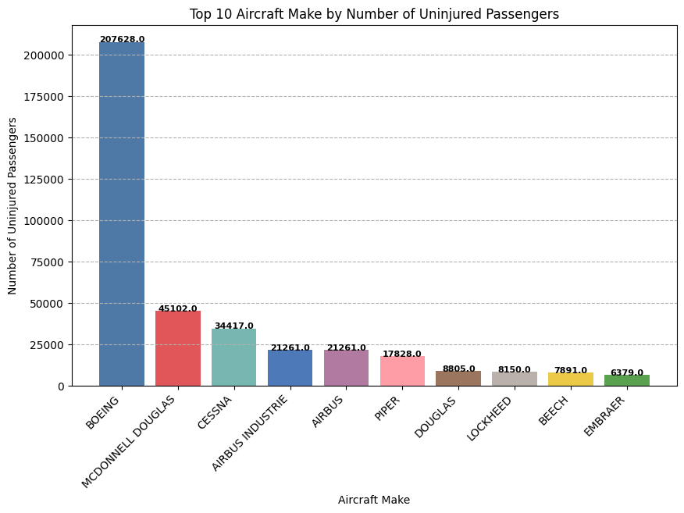
Uninjured Passengers by Make
Despite BOEING being involved in several of accidents, the number of uninjured passengers is very high
CESSNA having been involved in the most accidents from the above analysis, the number of uninjured passengers is quite low.

Slide 9
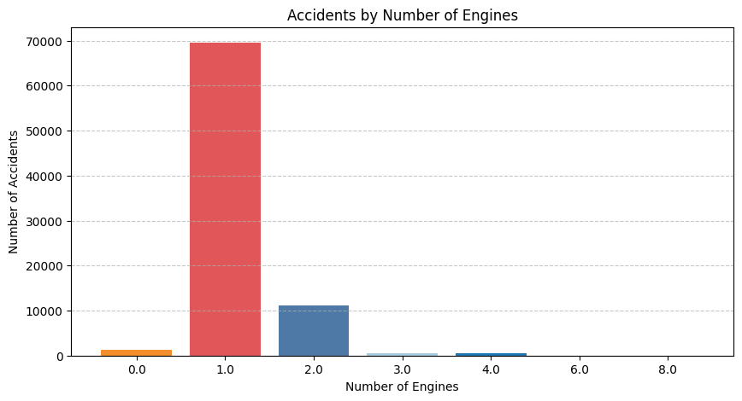
Analysis By Number of Engines
From the analysis of accidents by the number of engines,
Most accidents occur where planes have one engine.
Relatively lesser accidents occur where an airplane has more than one engine.

Slide 10
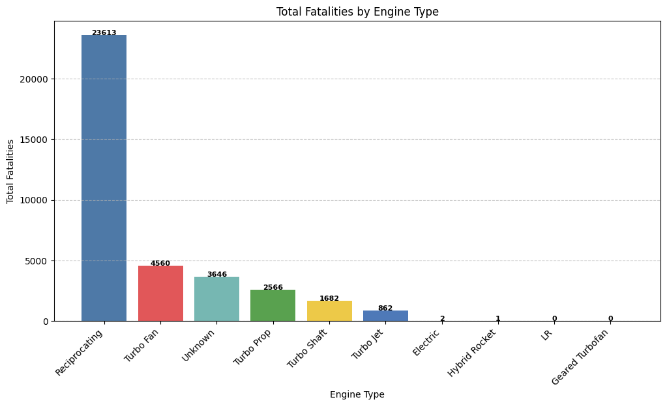
Fatality by Engine Type
Certain engine types such as RECIPROCATING are involved in the most accidents.
Fatality rate is also high on planes having the same engine.

Slide 11
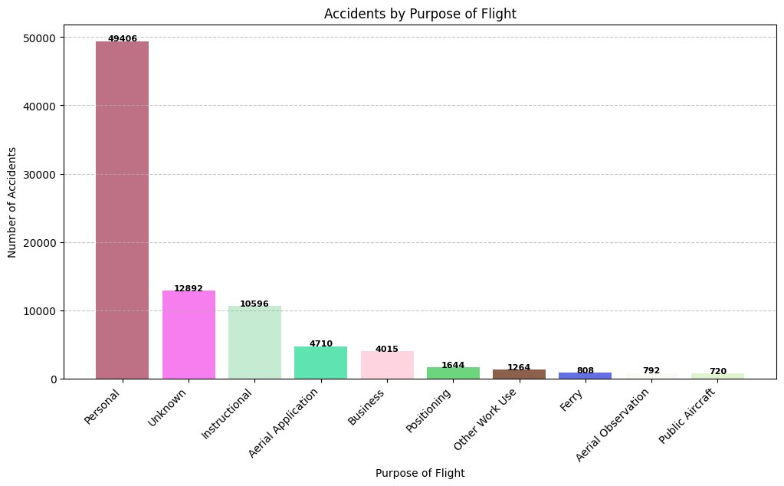
Analysis by Purpose of Flight
Personal use planes tend to be involved in most accidents with almost half the number of accidents reported.

Slide 12
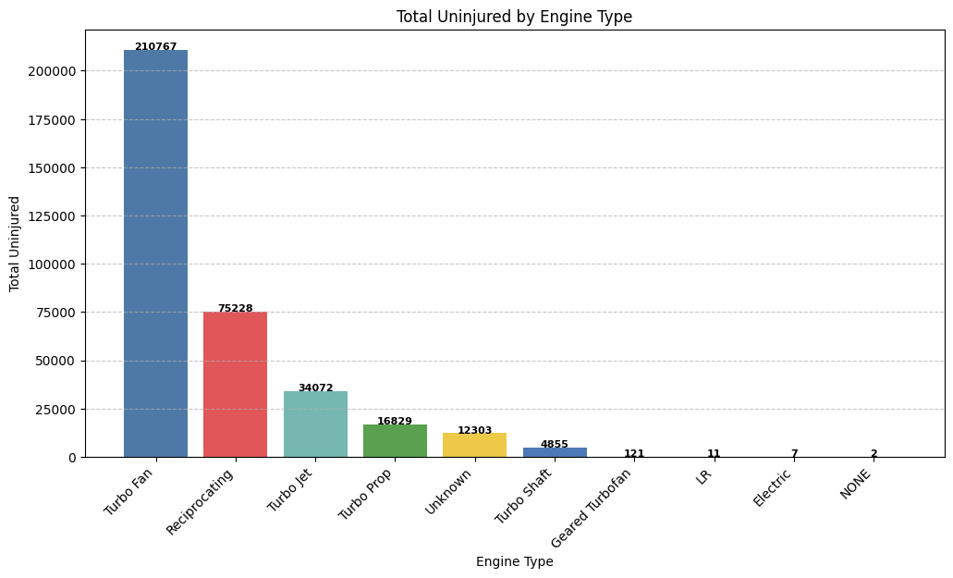
Uninjured Passengers by Engine type
Planes with Turbo Fun are relatively safe compared to other engine types as the number of uninjured passengers is high.

Slide 13
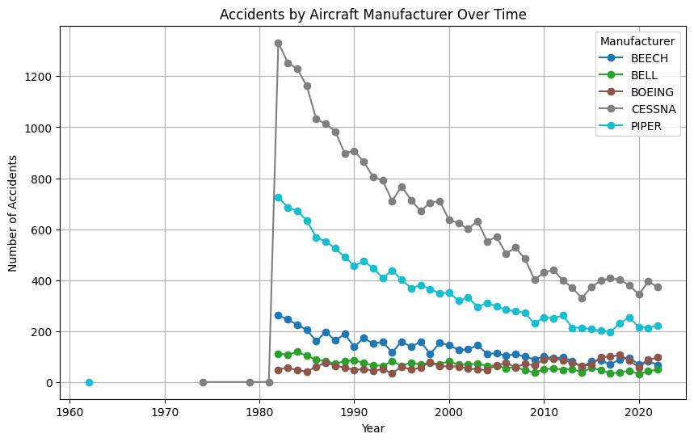
Accidents by Aircraft Manufacturer Over Time
Aircraft accidents have generally reduced over the years

Slide 14
Recommendations
Aircraft Make and Model
Focus should be on models and makes with the least number of accidents and a high number of survival rate
Engine Type and number of engines
Airoplans with more than one engine are relatively save hence should be considired.
Flight Purpose and Risk Levels
The business should prioritize business and less risky flight purposes when entering the industry.
Proper training of pilots and high observation on variours weather conditions should be considered.

Slide 15
Thank you
Charles Owiti
Charles.owiti@student.moringaschool.com

